Slide 1

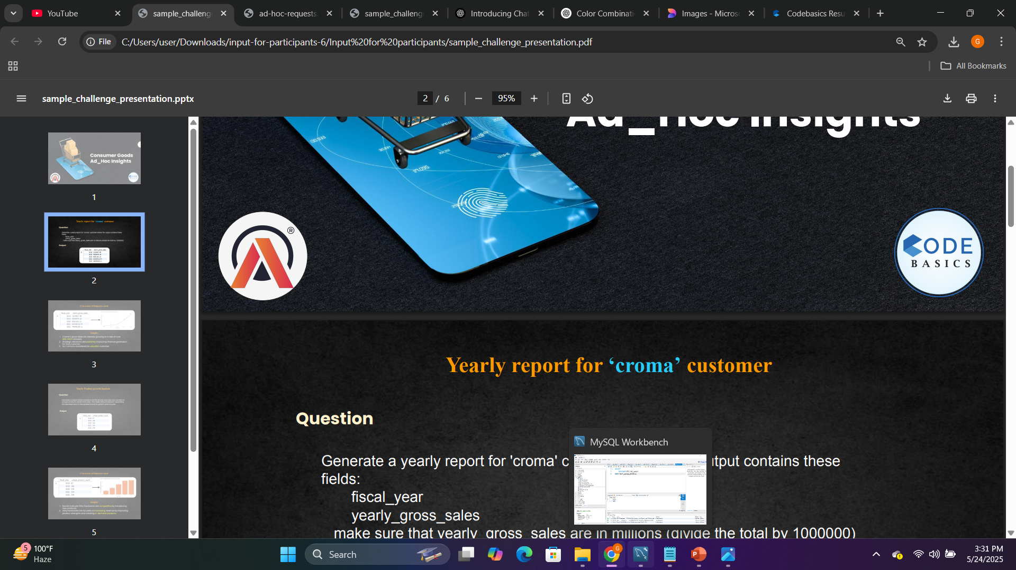

Consumer Goods Ad_Hoc Insights
Challenge :-4 Provide Insights to Management in Consumer Goods Domain
Presented by :- Gagandeep Kaur Bhatti

Slide 2
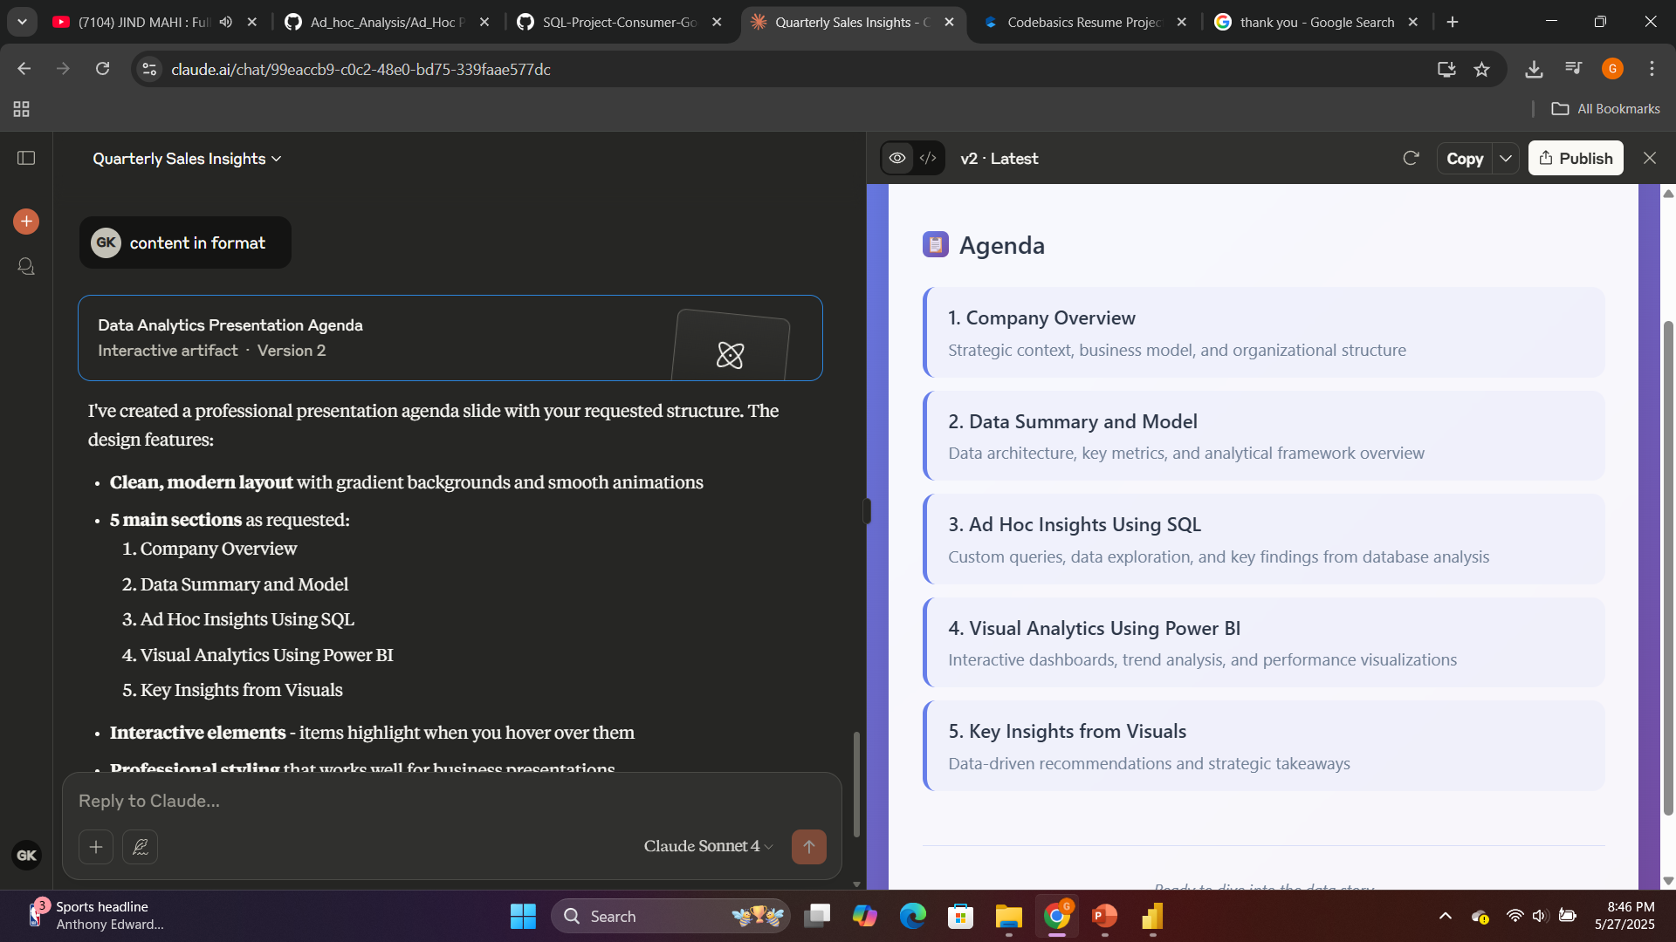

Slide 3
AtliQ Hardware Overview
Domain: Consumer Goods
Function: Executive Management
AtliQ Hardware is a technology-driven manufacturer and distributor of computer hardware, operating globally across multiple regions including APAC, EU, NA, and LATAM. The company offers a wide range of products such as laptops, desktops, peripherals, accessories, storage devices, and networking equipment. AtliQ Hardware leverages both Brick & Mortar and E-Commerce platforms, with distribution channels including Retailers, Distributors, and Direct Sales.
The fiscal year for Atliq Hardware begins in September and ends in August.

Slide 4

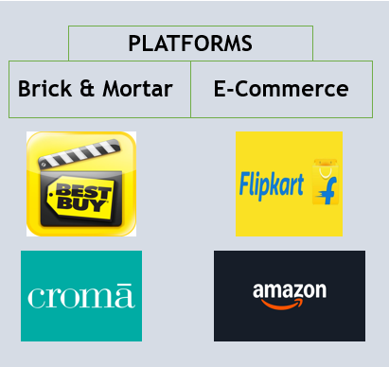

AtliQ Hardware serves two main types of customers:
Retail Stores: Physical shops like Best Buy and Croma.
Online Platforms: Big e-commerce sites like Flipkart and Amazon.
By selling through both stores and online platforms, AtliQ Hardware reaches more customers and strengthens its market presence.
Product Distribution Flow
AtliQ Hardware
Selling Hardware Products
To End Consumers
Using These Platforms

Slide 5
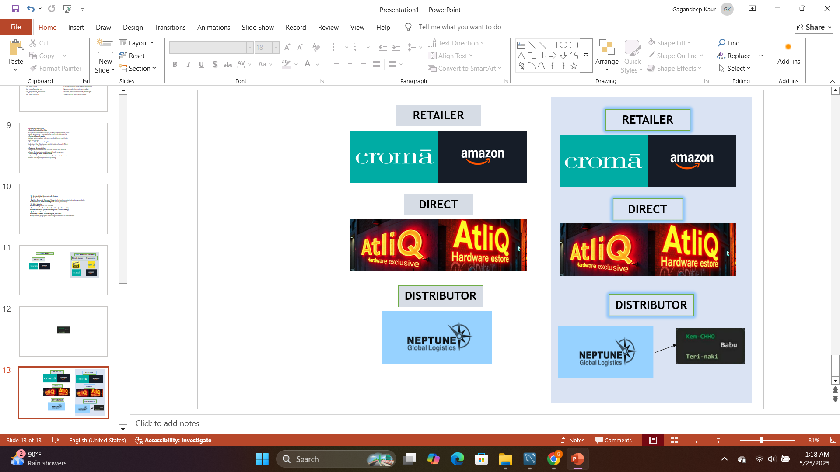
AtliQ Hardware sells its products through three main channels:
Retailer Channel: AtliQ works with popular retailers like Croma, Amazon, and Best Buy to reach a large number of customers.
Direct Channel: Customers can buy directly from AtliQ through the AtliQ Exclusive stores and the AtliQ E-store, offering a convenient and customized shopping experience.
Distributor Channel: Distributors like Neptune and Sage help deliver AtliQ products to stores across various cities, ensuring wider availability.
AtliQ Hardware
Selling Hardware Products
To End Consumers
Using These Channels

Slide 6
📁 Database Summary
The data warehouse named atliq_hardware_db (gdb023) consists of six essential tables:
Table Name | Purpose
dim_customer | Contains customer details and segmentation
dim_product | Contains product hierarchy and classification
fact_gross_price | Captures product prices before deductions
fact_manufacturing_cost | Records production costs per product
fact_pre_invoice_deductions | Includes pre-invoice discount percentages
fact_sales_monthly | Tracks monthly sales performance

Slide 7
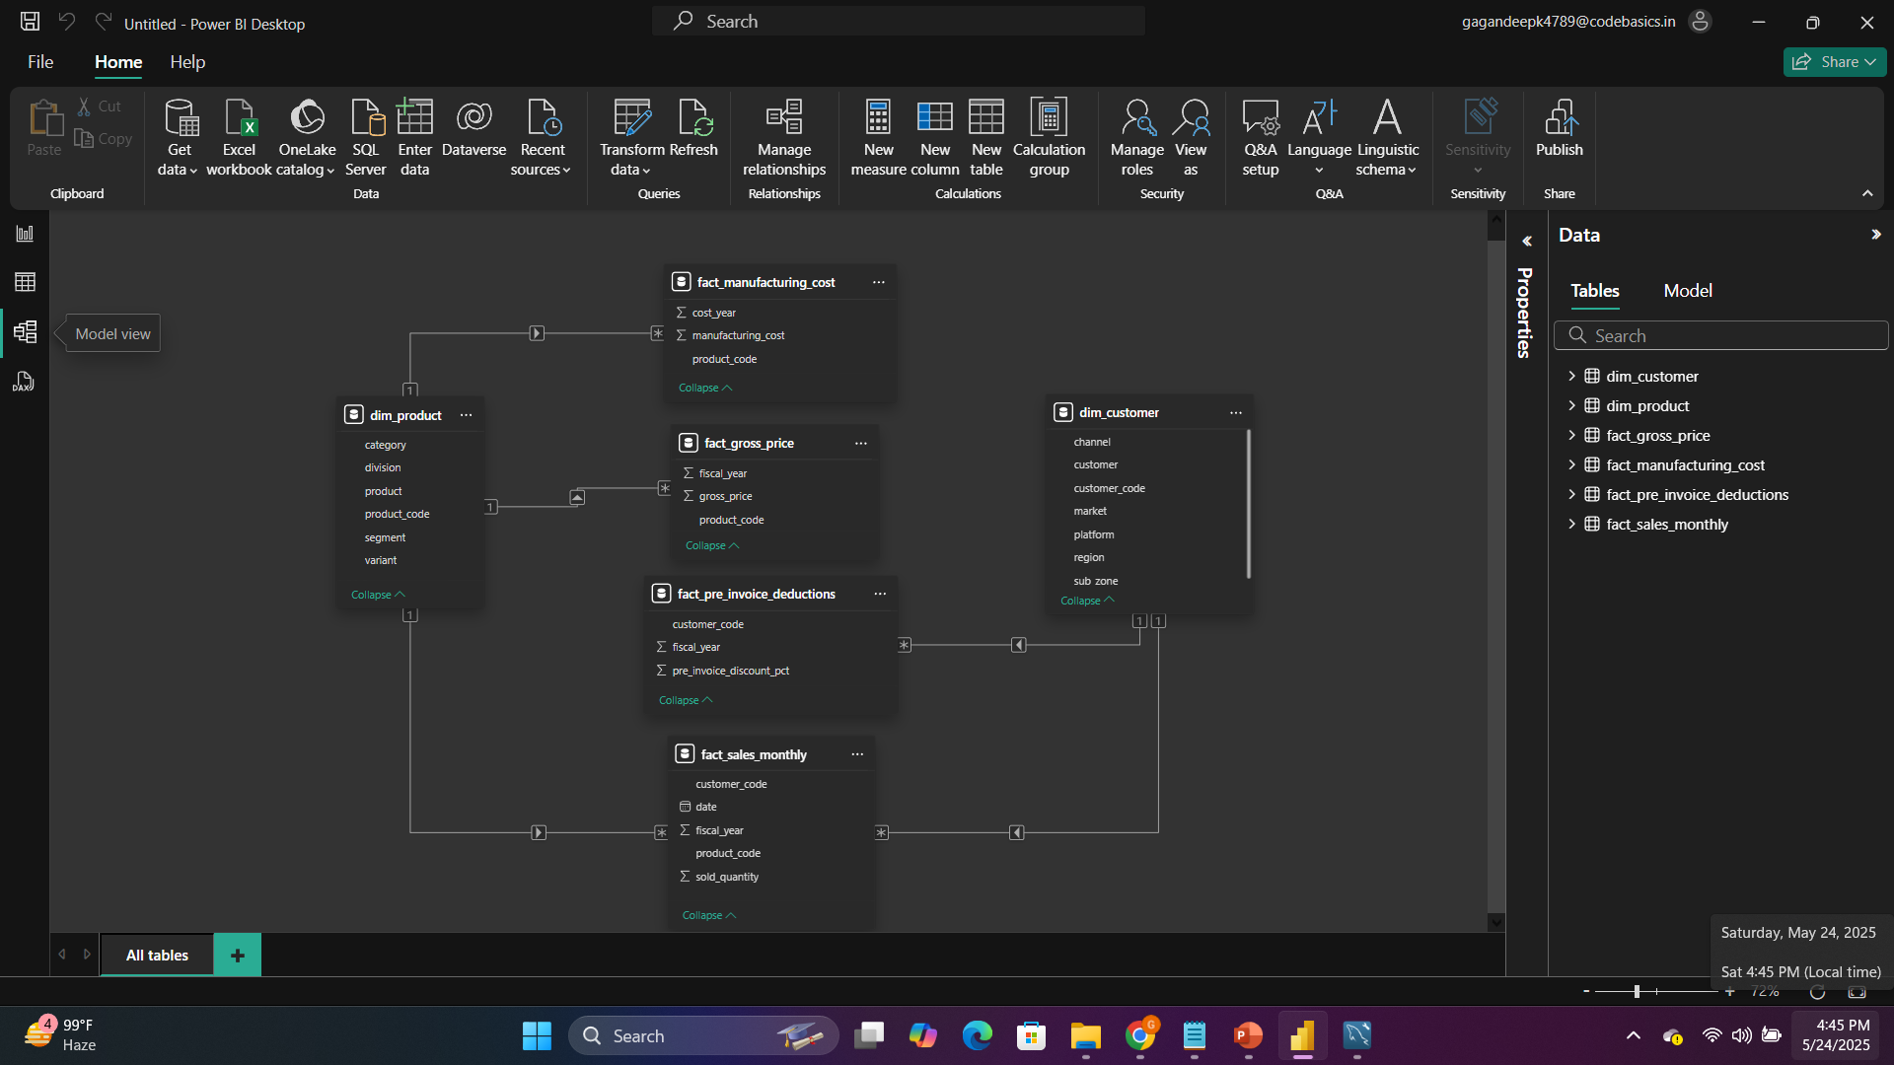
DATA MODEL

Slide 8
🎯 Business Objectives
Optimize Product Portfolio Identify high and low performing products by comparing gross margin (gross price - manufacturing cost) and sold quantity.
Regional Sales Analysis Evaluate which regions, sub-zones, and platforms contribute most to revenue.
Channel Performance Insights Understand the effectiveness of distribution channels (Direct vs. Retailers vs. Distributors).
Customer Segmentation Categorize customers based on sales volume and discount behavior for targeted marketing and loyalty programs.
Forecasting & Trend Identification Analyze monthly sales trends across fiscal years to forecast demand and improve production planning.

Slide 9
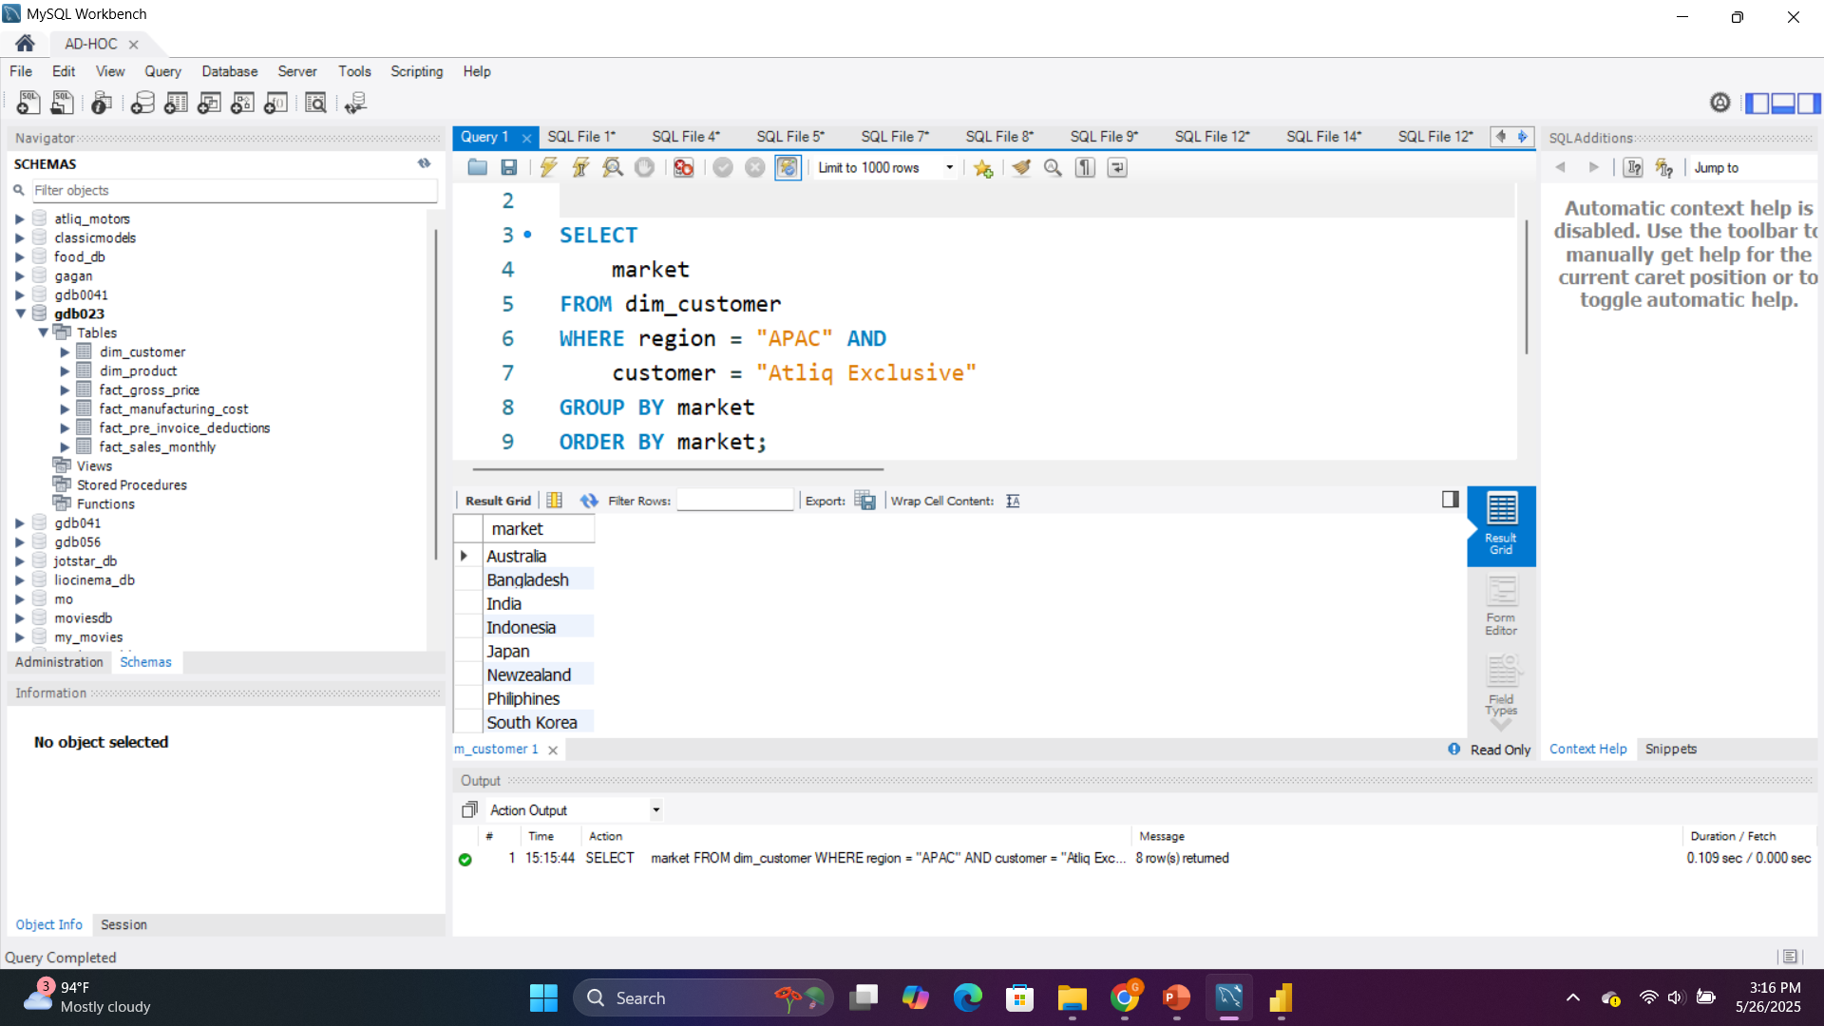
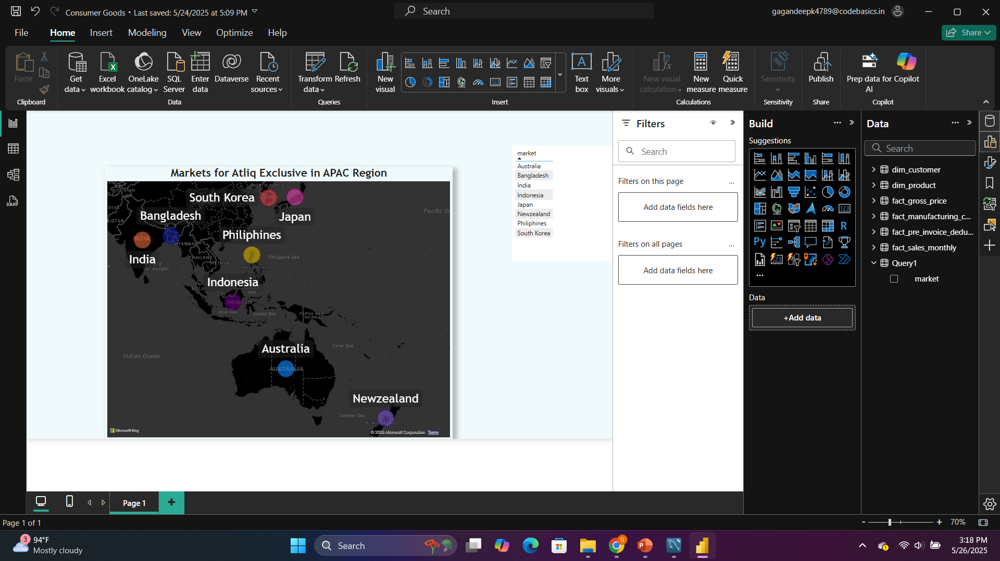
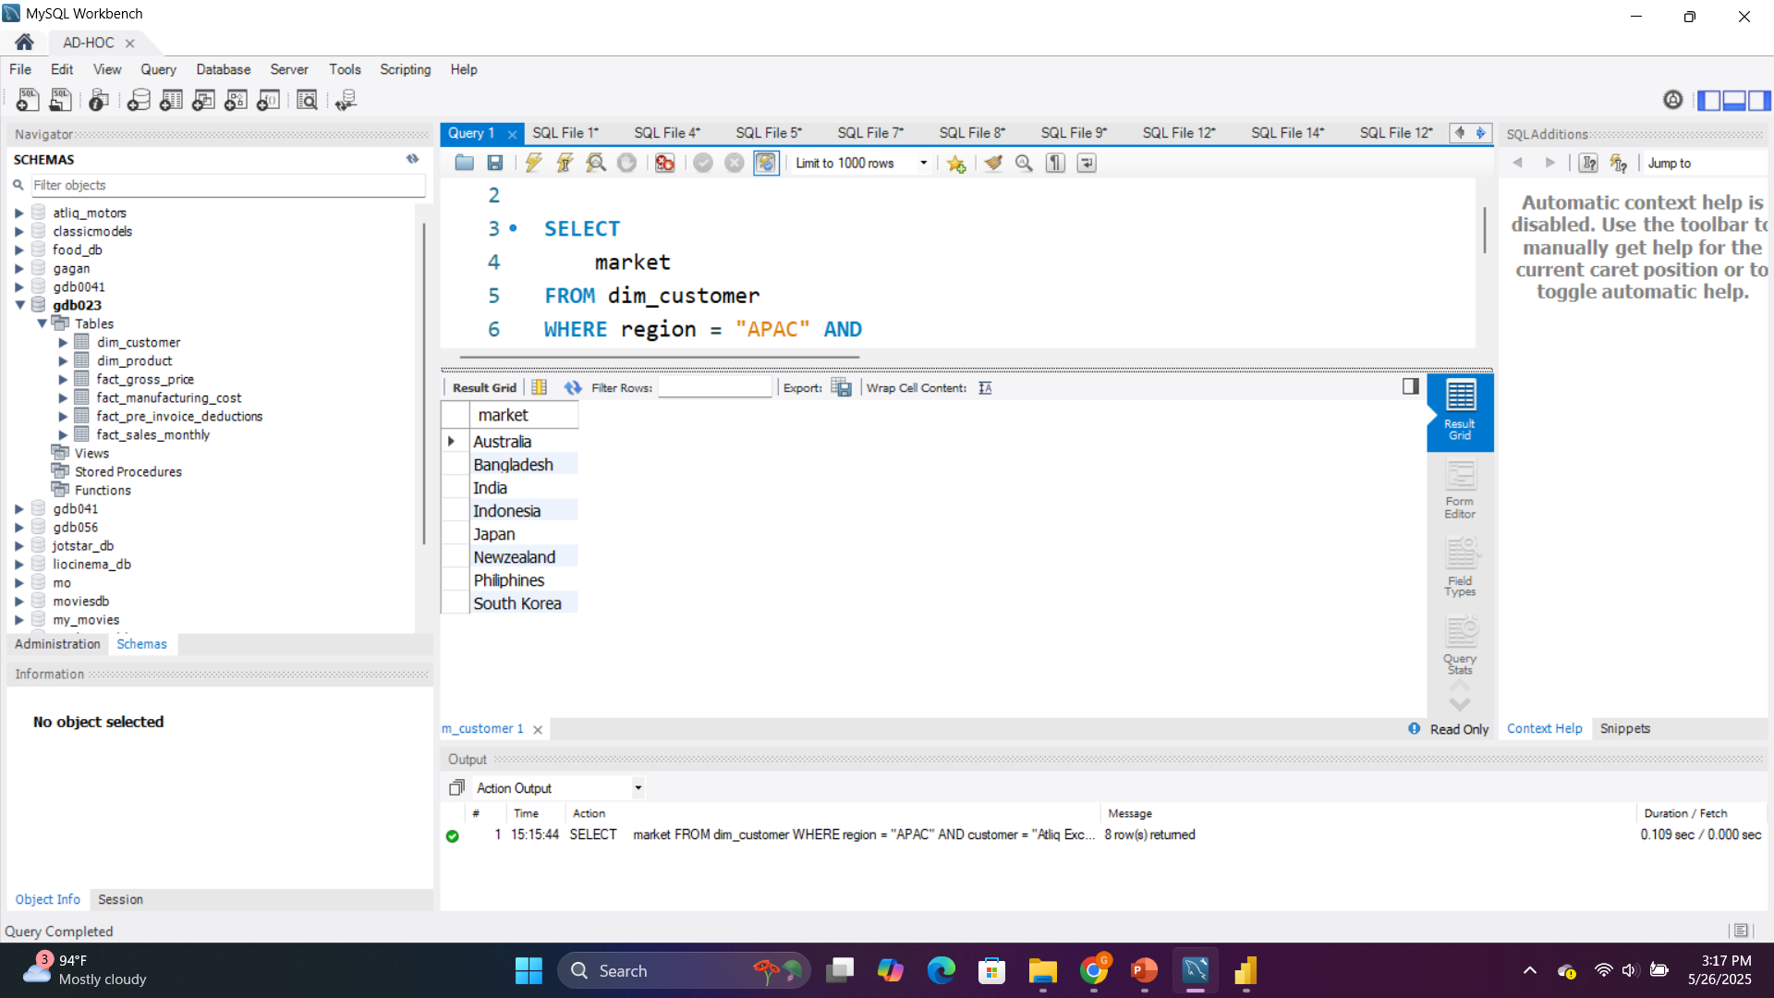
Provide the list of markets in which customer "Atliq Exclusive" operates its business in the APAC region.
The image displays a map titled “Markets for Atliq Exclusive in APAC Region” highlights the countries where Atliq Exclusive operates.

Slide 10
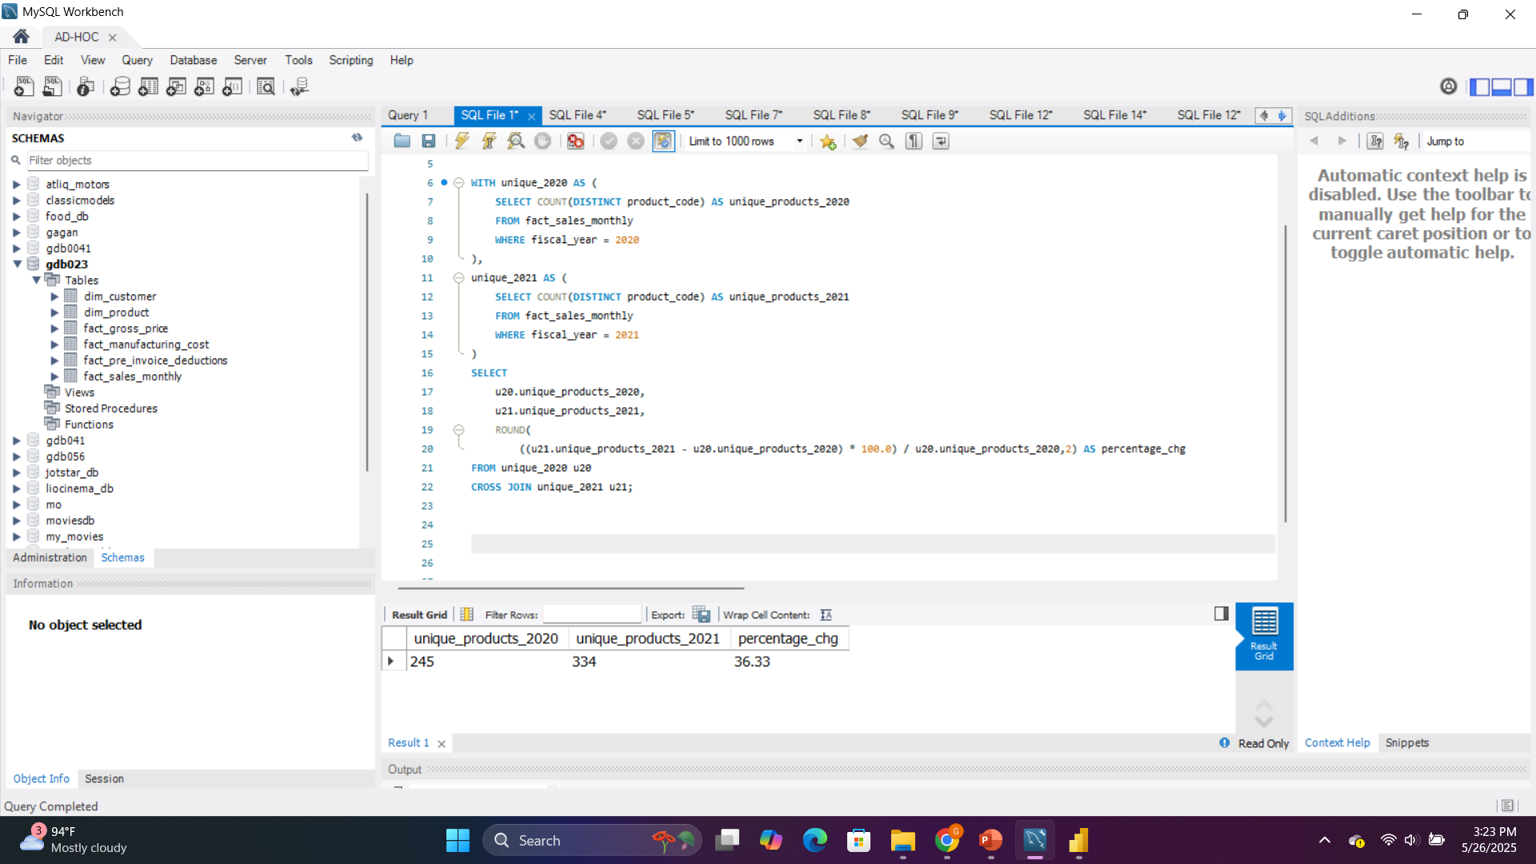
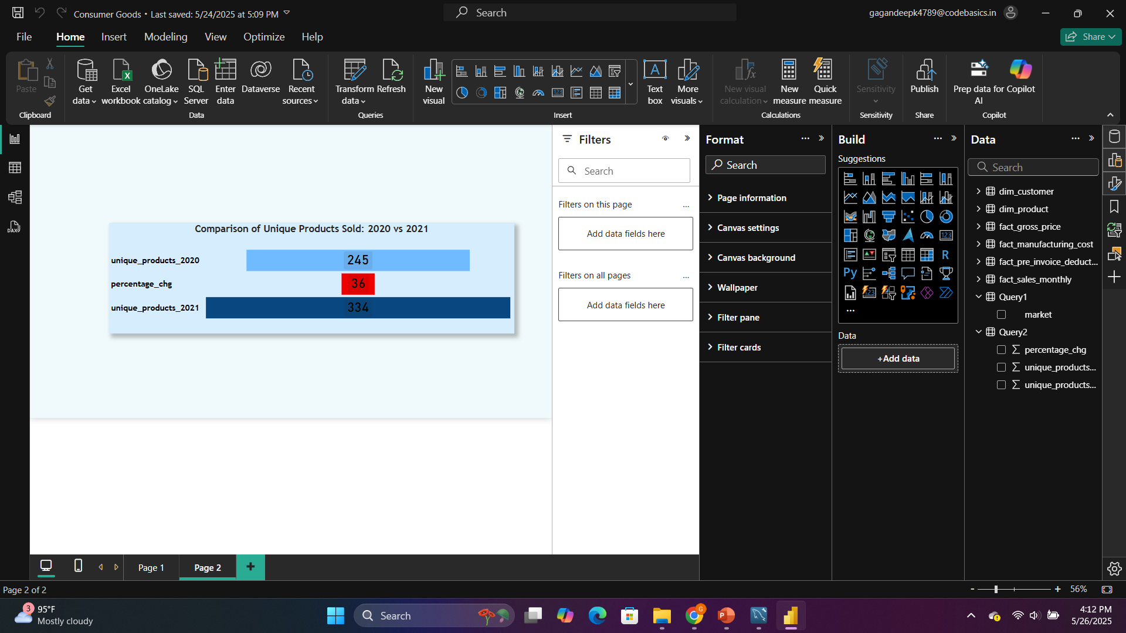
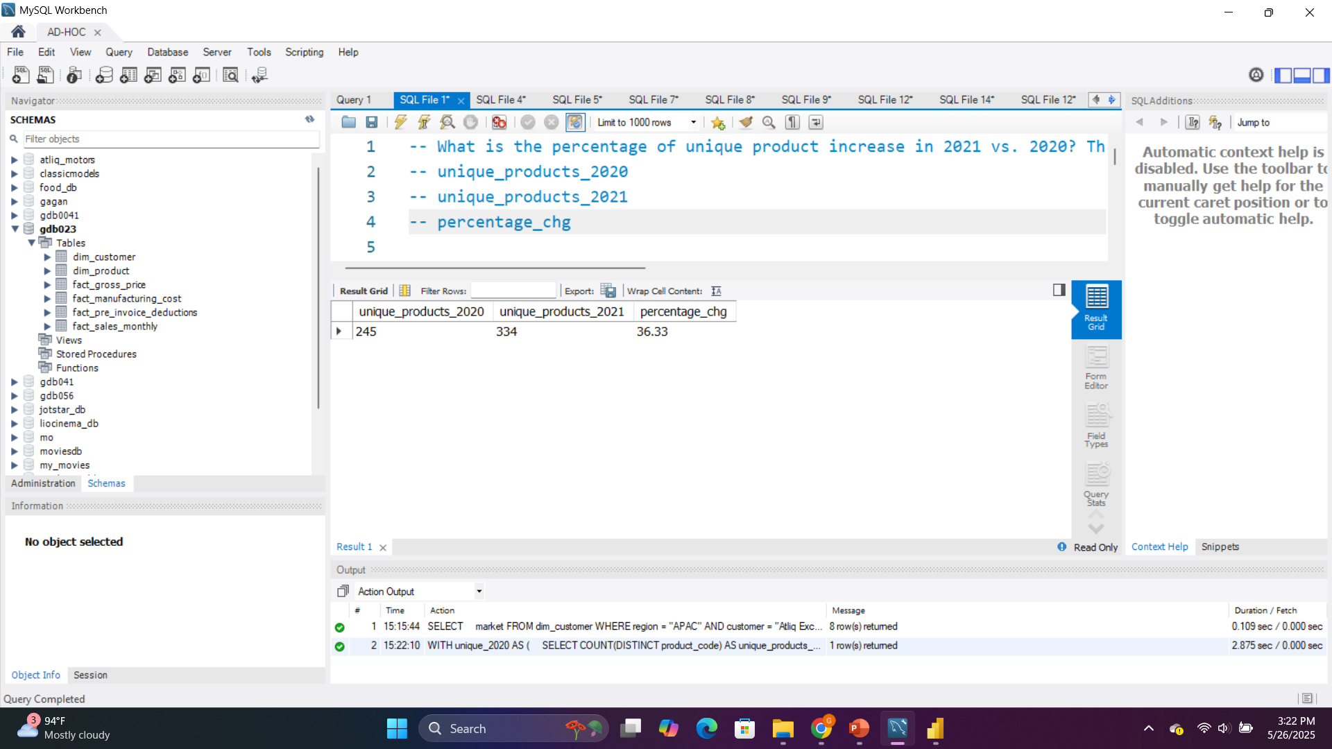
What is the percentage of unique product increase in 2021 vs. 2020? The final output contains these fields, unique_products_2020 ,unique_products_2021 & percentage_chg
Atliq Exclusive increased its product variety significantly in 2021, selling 89 more unique products than in 2020 — a 36% growth. This suggests a strategy of product diversification or expanded market reach.

Slide 11
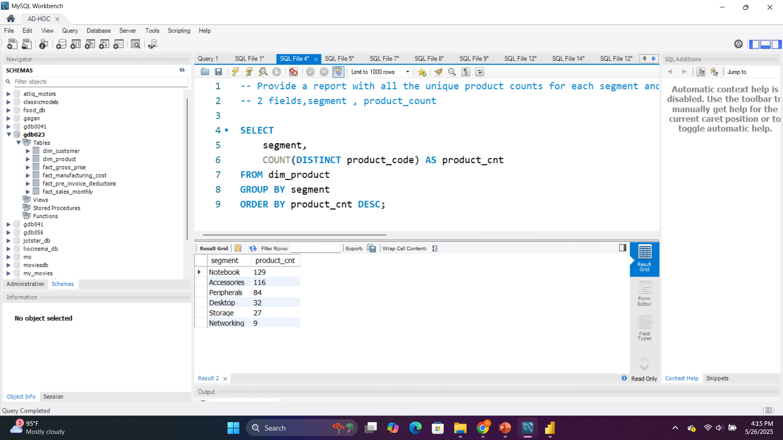
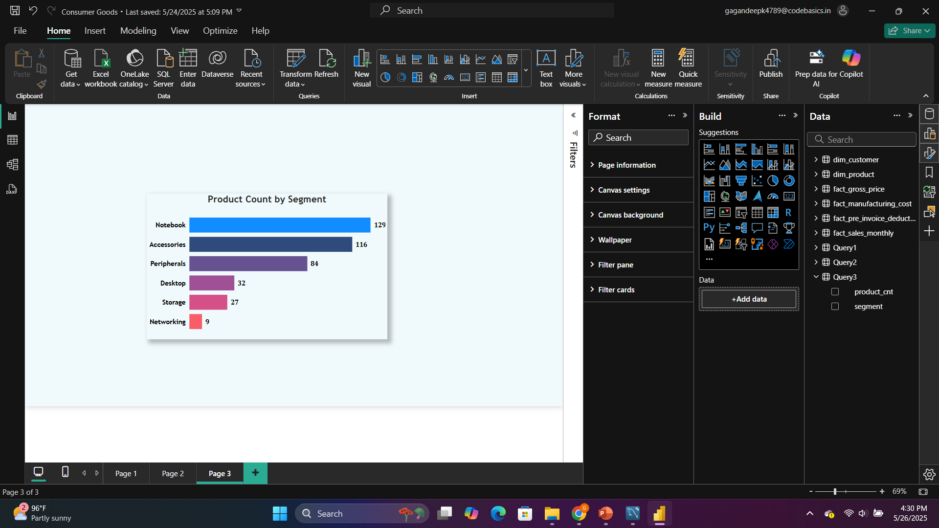
Provide a report with all the unique product counts for each segment and sort them in descending order of product counts. The final output contains 2 fields, segment product_count

Slide 12
Top Product Segment
Least Represented Segment
Top Product Segment:
Notebook leads with 129 products, followed by Accessories (116) and Peripherals (84).
Least Represented Segments:
Networking (9) and Storage (27) have the fewest products, indicating lower focus or limited offerings in these categories.
💡 Suggestion:
Expand Lower Segments: Consider diversifying and growing product lines in Networking and Storage segments. These are critical in the tech ecosystem and represent untapped market potential.
Leverage Leading Segments: Maintain innovation and promotion in Notebooks and Accessories to continue capitalizing on their existing strong presence.

Slide 13
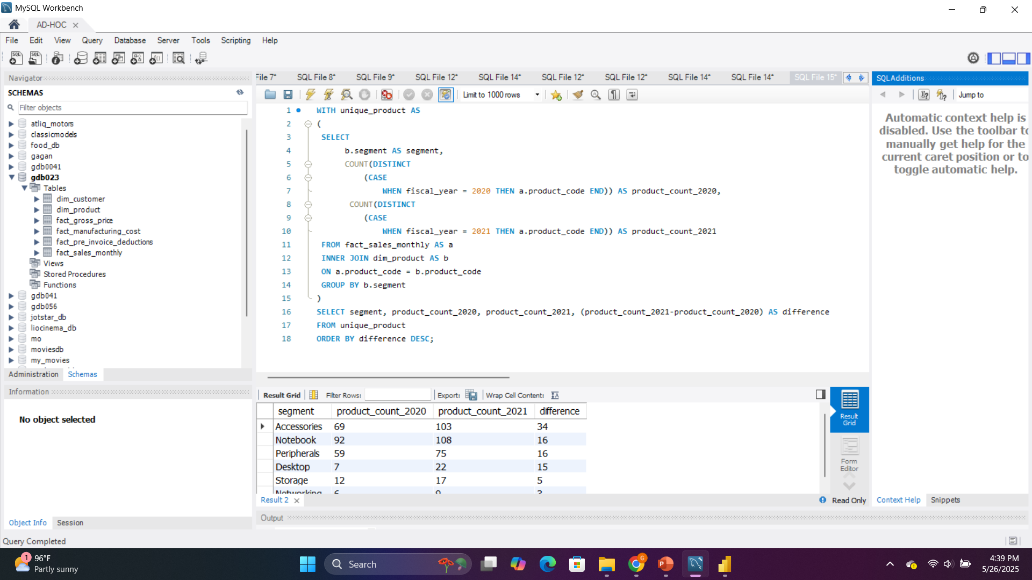
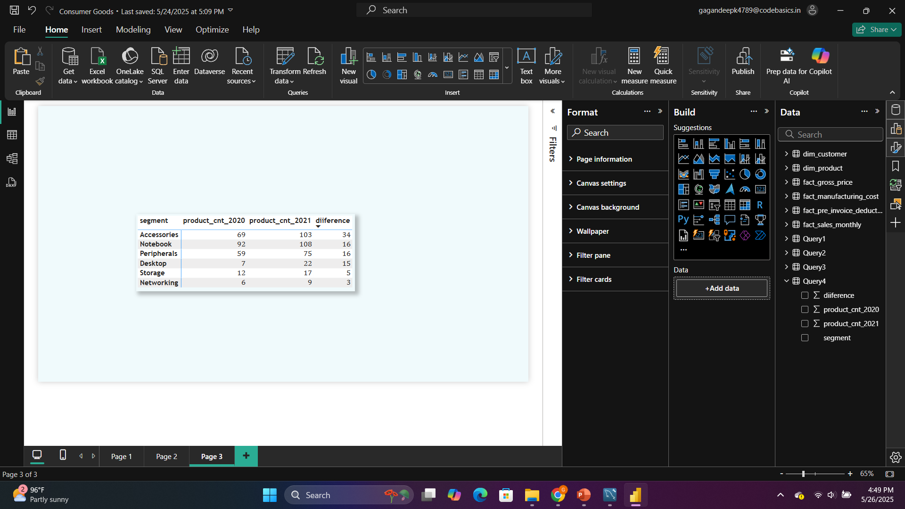
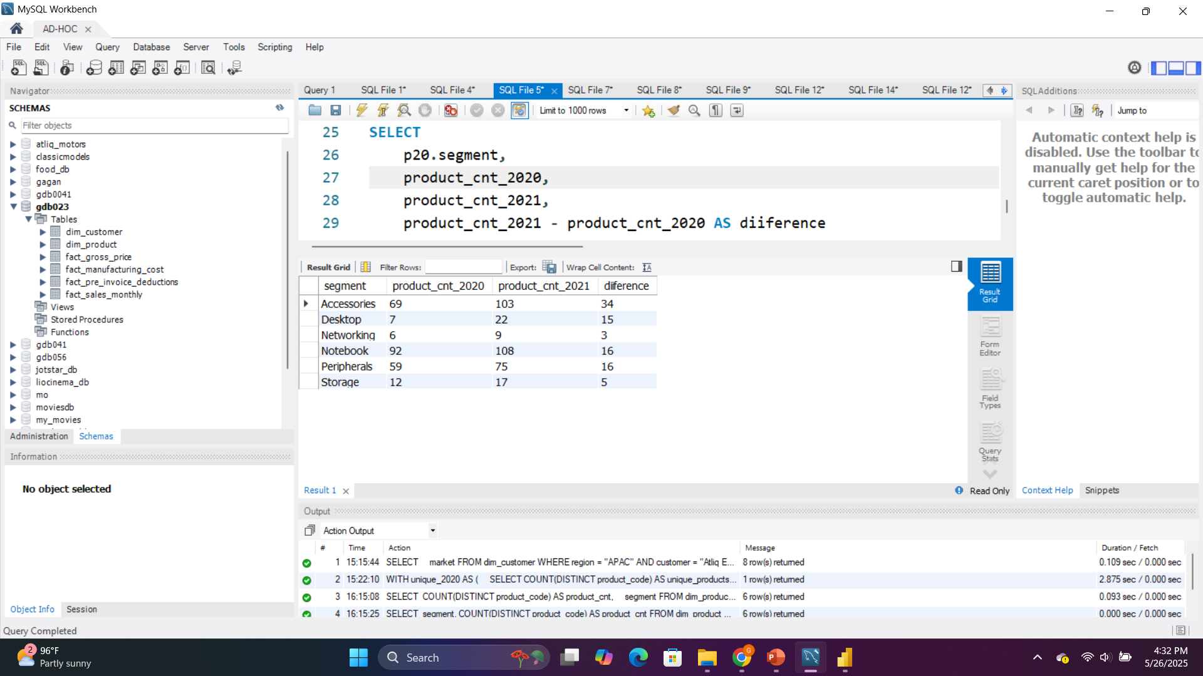
Follow-up: Which segment had the most increase in unique products in 2021 vs 2020? The final output contains these fields, segment product_count_2020, product_count_2021 & difference

Slide 14
All segments increased product counts in 2021 compared to 2020.
Top growth was in:
Accessories: +34 products
Notebook and Peripherals: +16 each
Desktop: grew from 7 to 22 (+15)
💡 Suggestion:
Keep investing in Accessories – it showed the biggest growth and strong demand.
Desktop segment had significant percentage growth (more than 3x) – explore more opportunities here.
Networking had the lowest increase – consider product development or marketing focus to grow this underrepresented area.

Slide 15
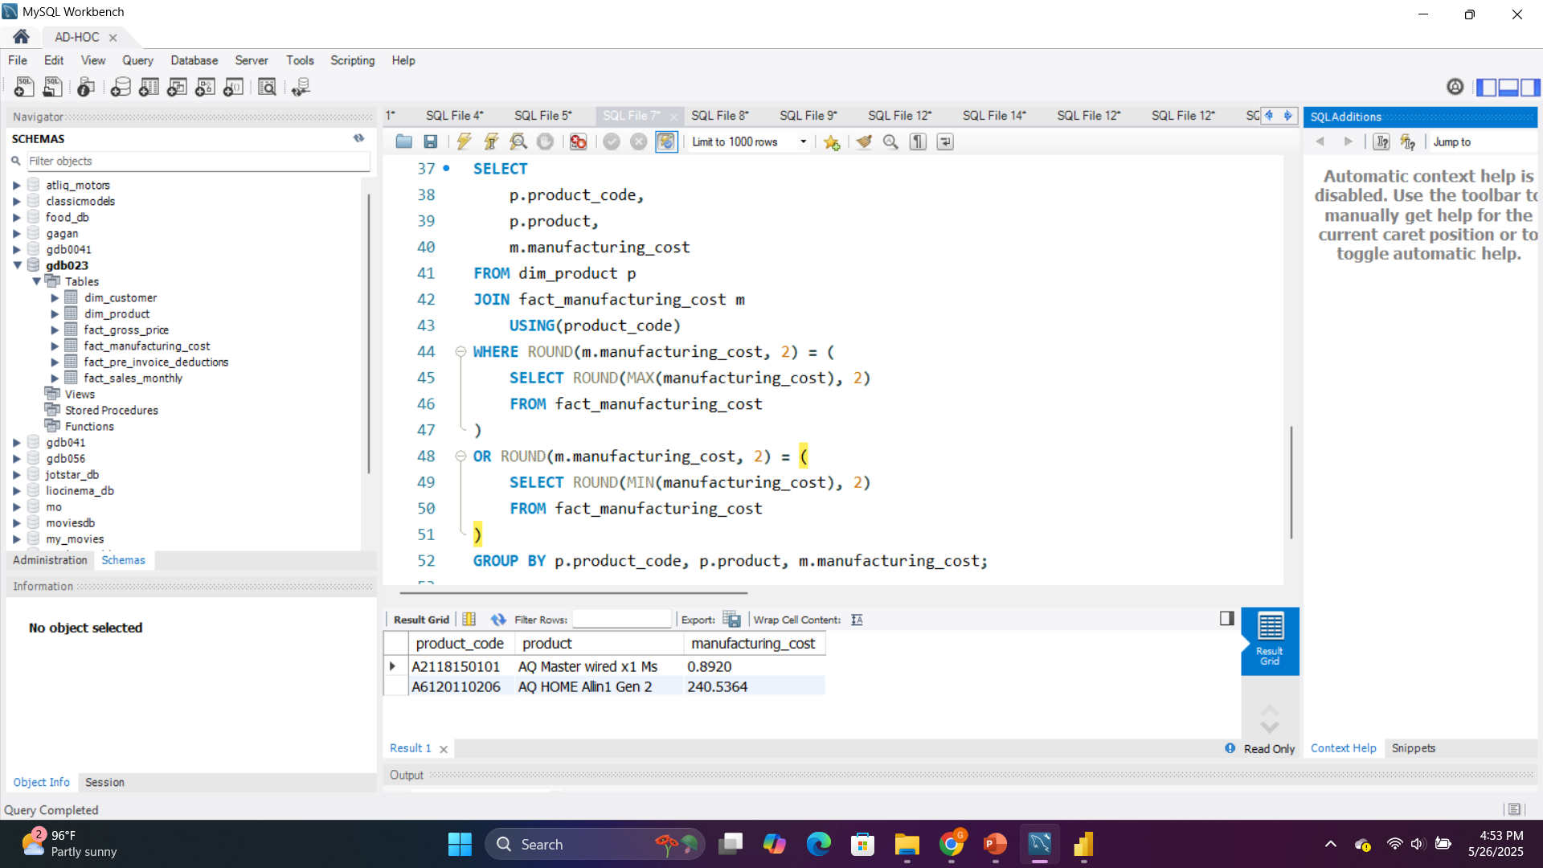
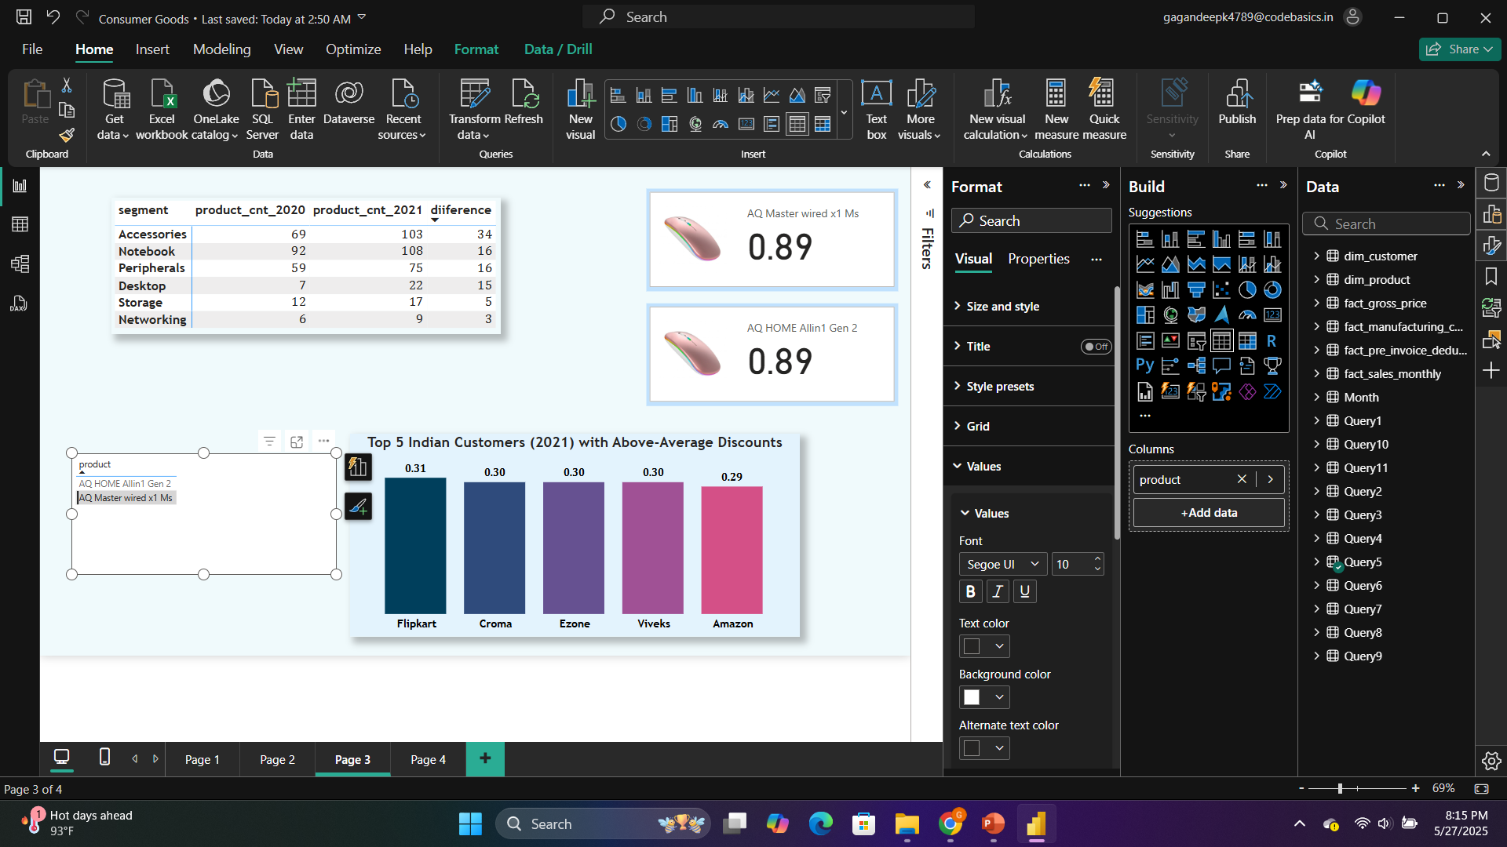
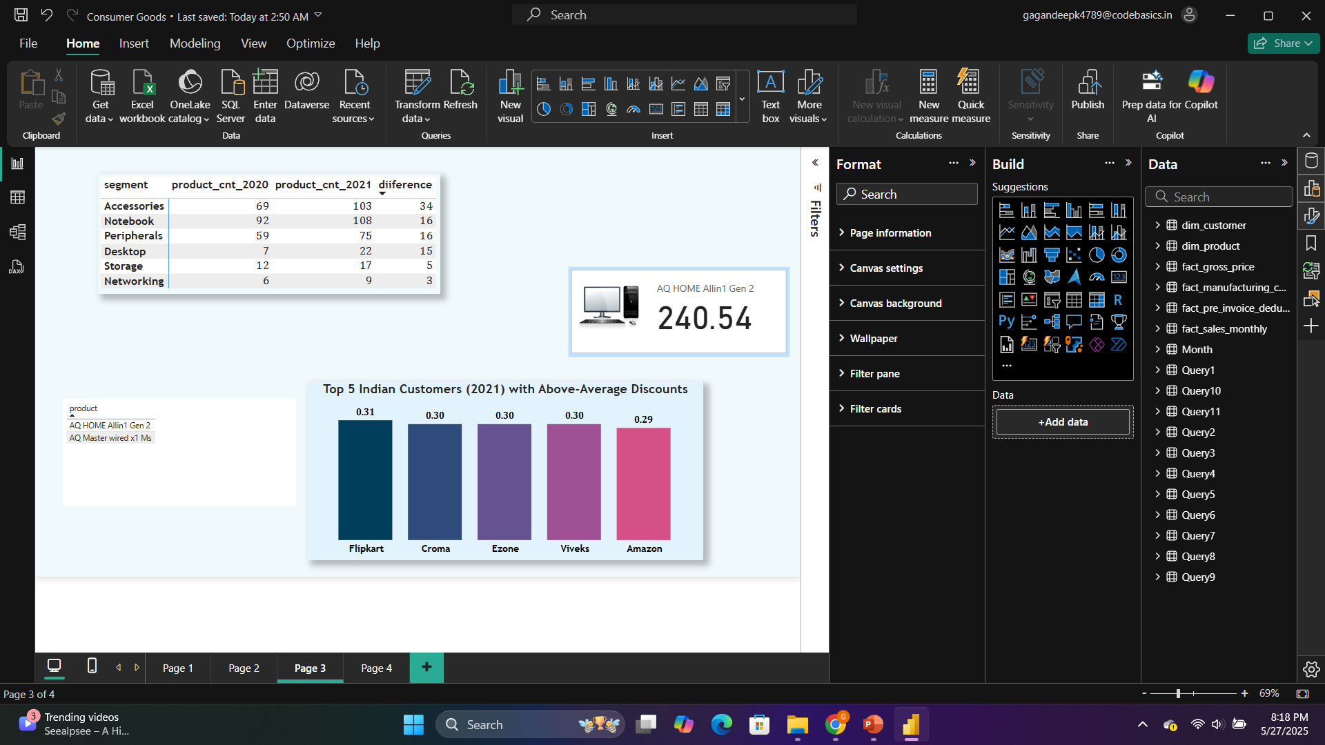
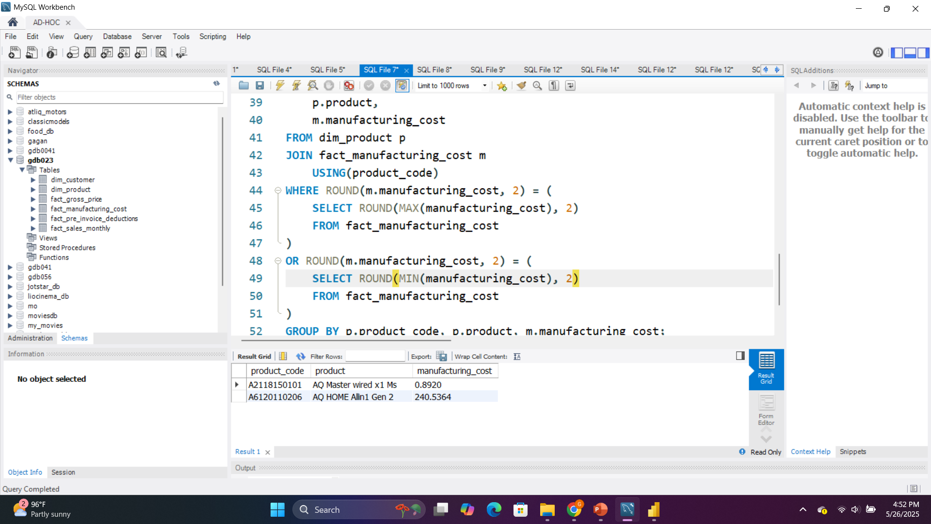
Get the products that have the highest and lowest manufacturing costs. The final output should contain these fields, product_code, product & manufacturing_cost
🔼 Highest Manufacturing Cost Product:
Product: AQ HOME Allin1 Gen 2
Cost: 241.43
🔽 Lowest Manufacturing Cost Product:
Product: AQ Master wired x1 Ms
Cost: ₹0.89

Slide 16
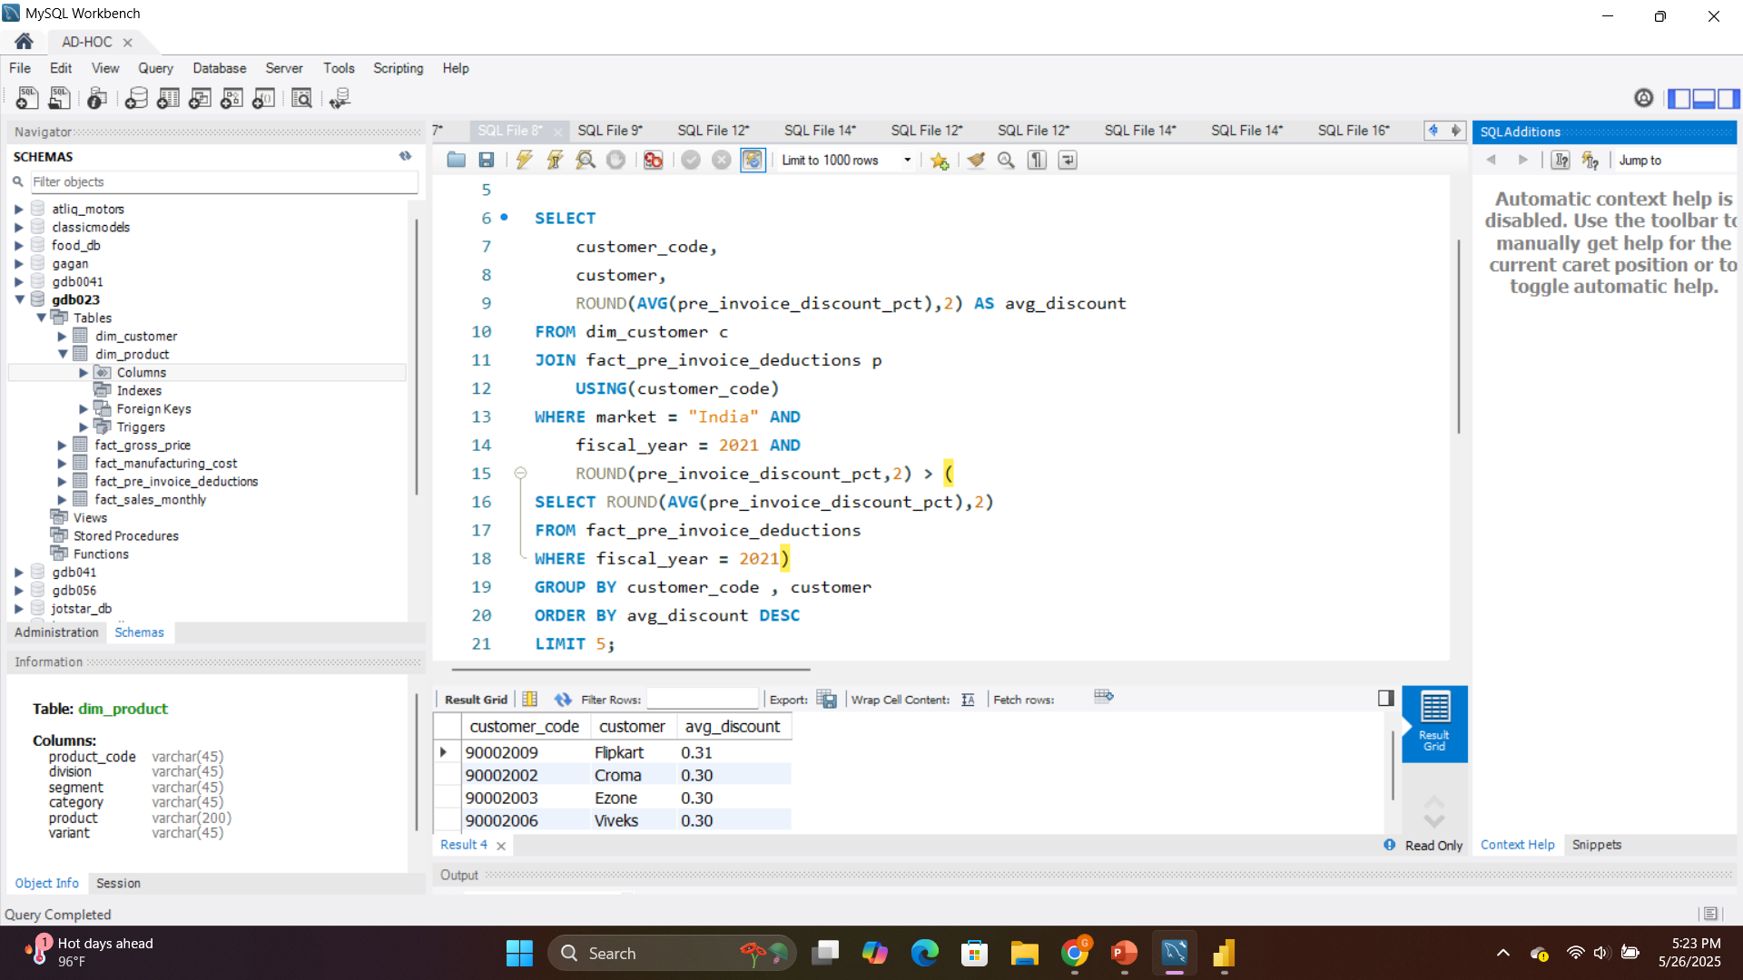
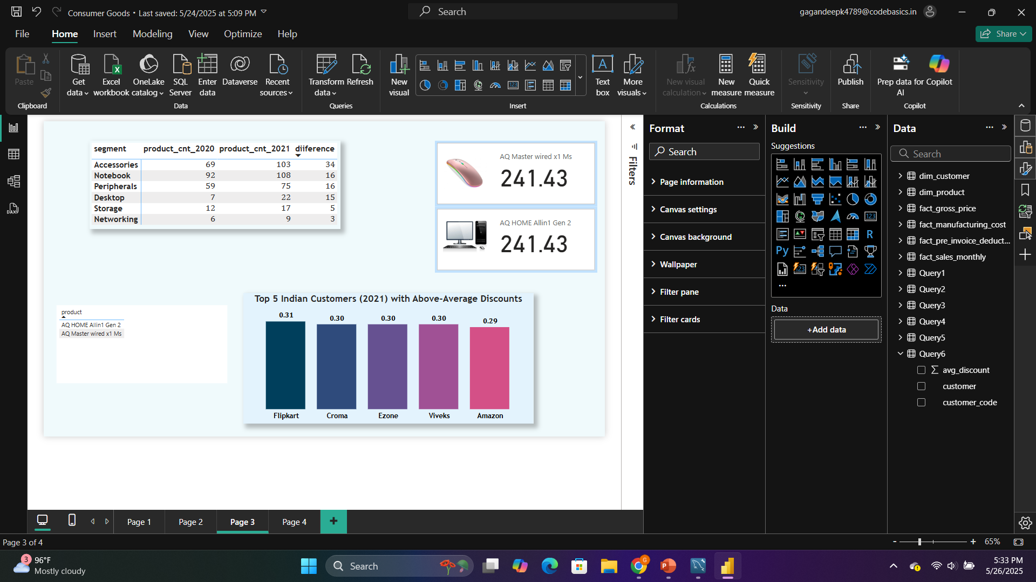
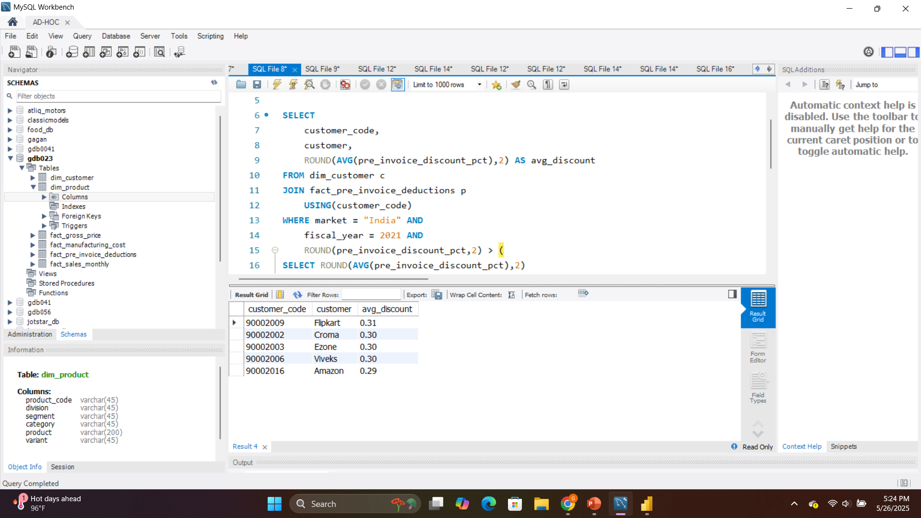
Generate a report which contains the top 5 customers who received an average high pre_invoice_discount_pct for the fiscal year 2021 and in the Indian market. The final output contains these fields, customer_code, customer, average_discount_percentage

Slide 17
Top 5 Indian customers in 2021 received higher-than-average discounts.
Flipkart got the highest average discount at 31%.
Other top customers like Croma, Ezone, Viveks, and Amazon also received discounts close to 30%.
These companies likely contributed high sales volume, which helped them negotiate better deals.

Slide 18
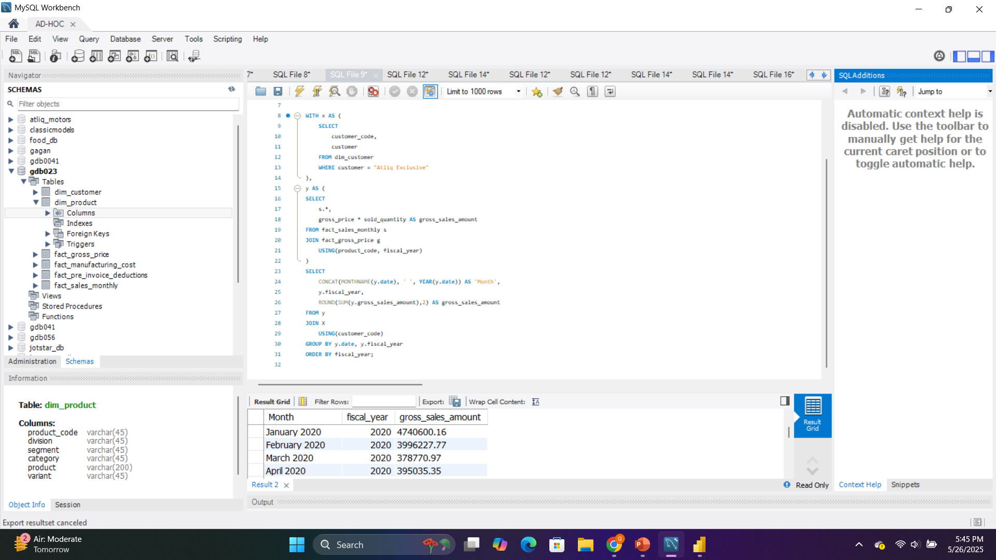
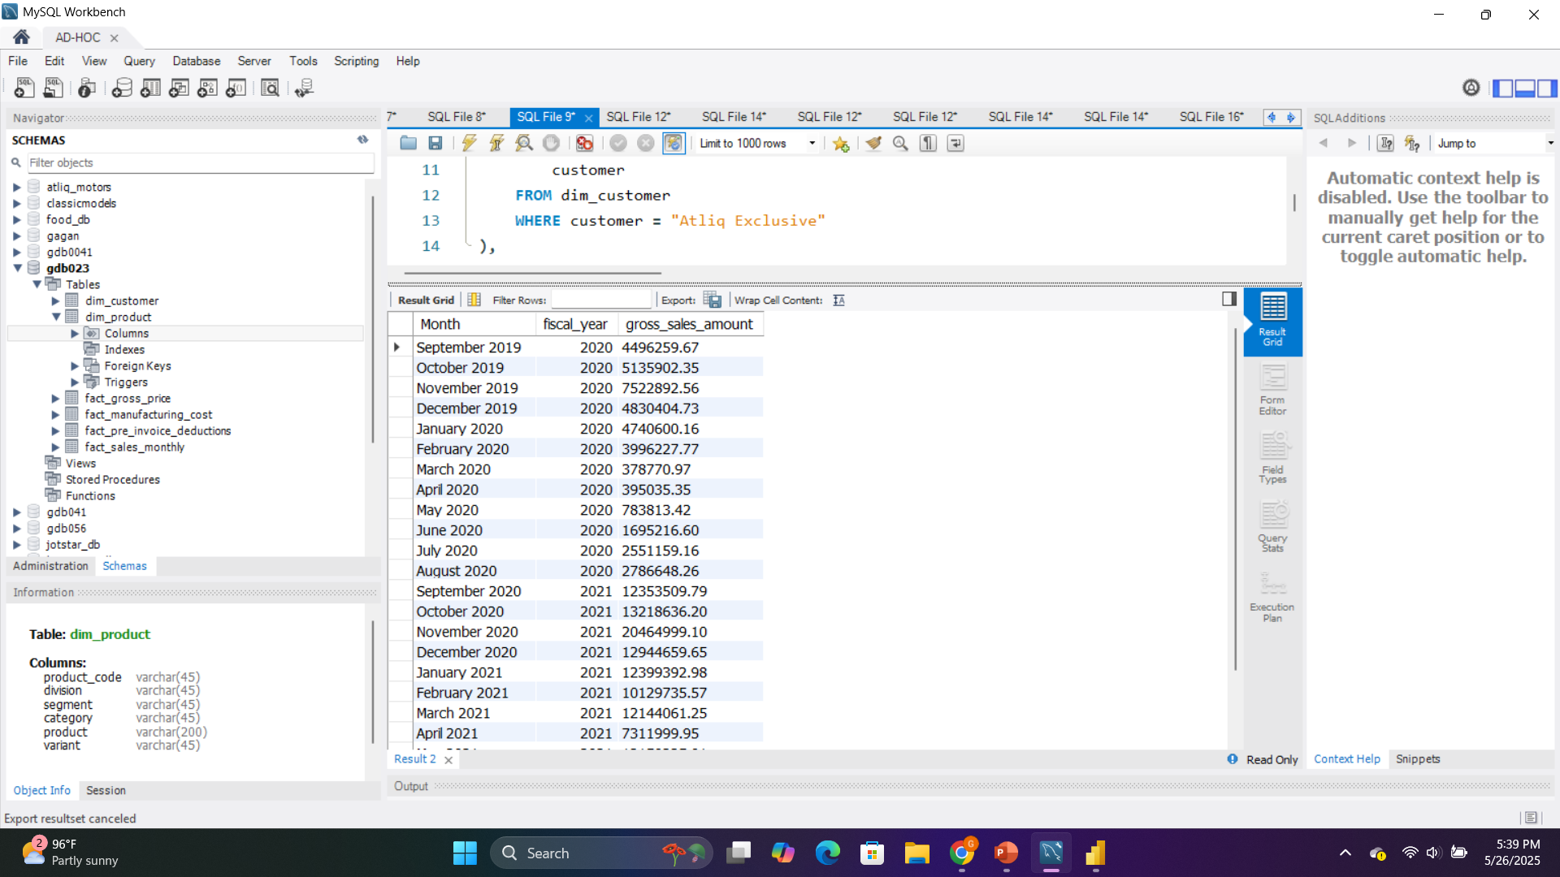
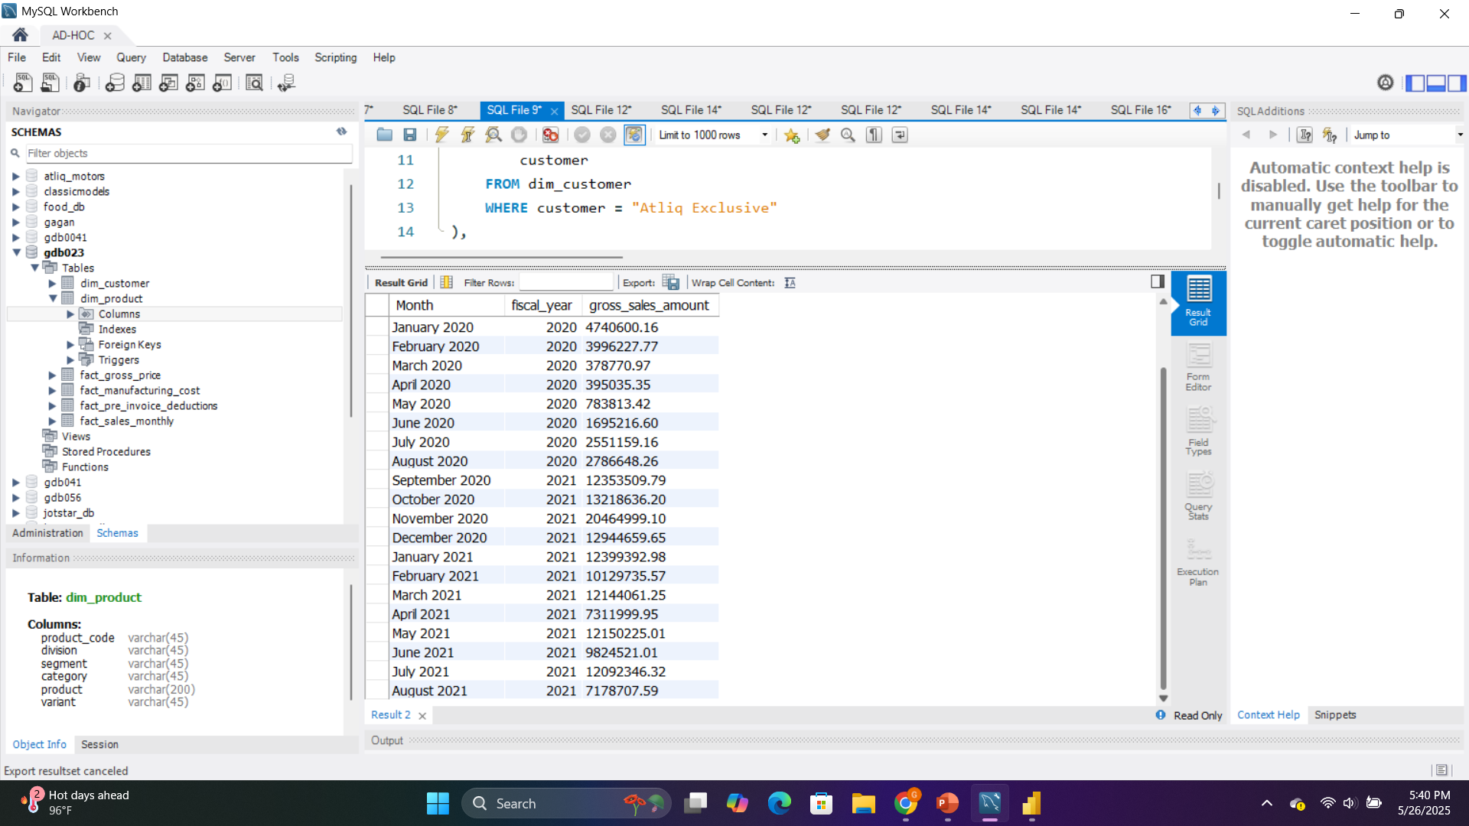
Get the complete report of the Gross sales amount for the customer “Atliq Exclusive” for each month. This analysis helps to get an idea of low and high-performing months and take strategic decisions. The final report contains these columns: Month ,Year & Gross sales Amount

Slide 19
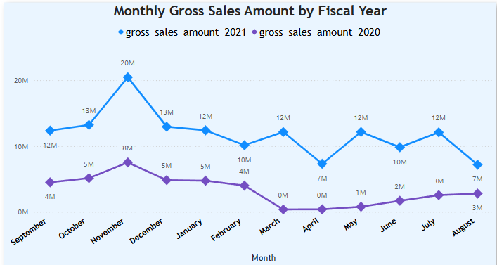
2021 Outperformed 2020: Every month in 2021 had much higher gross sales than 2020.
Peak in November 2021: Sales hit the highest point in November 2021 at 20M, likely due to festive shopping (e.g., Diwali).
Zero Sales in Early 2020 (Mar-Apr): March and April 2020 show 0 sales, possibly due to the COVID-19 lockdown.
Stable Growth in 2021: Sales remained consistently strong throughout 2021, fluctuating between 10M and 20M.
Low Activity in 2020: Sales stayed under 8M in most months in 2020, showing a weak performance overall.

Slide 20
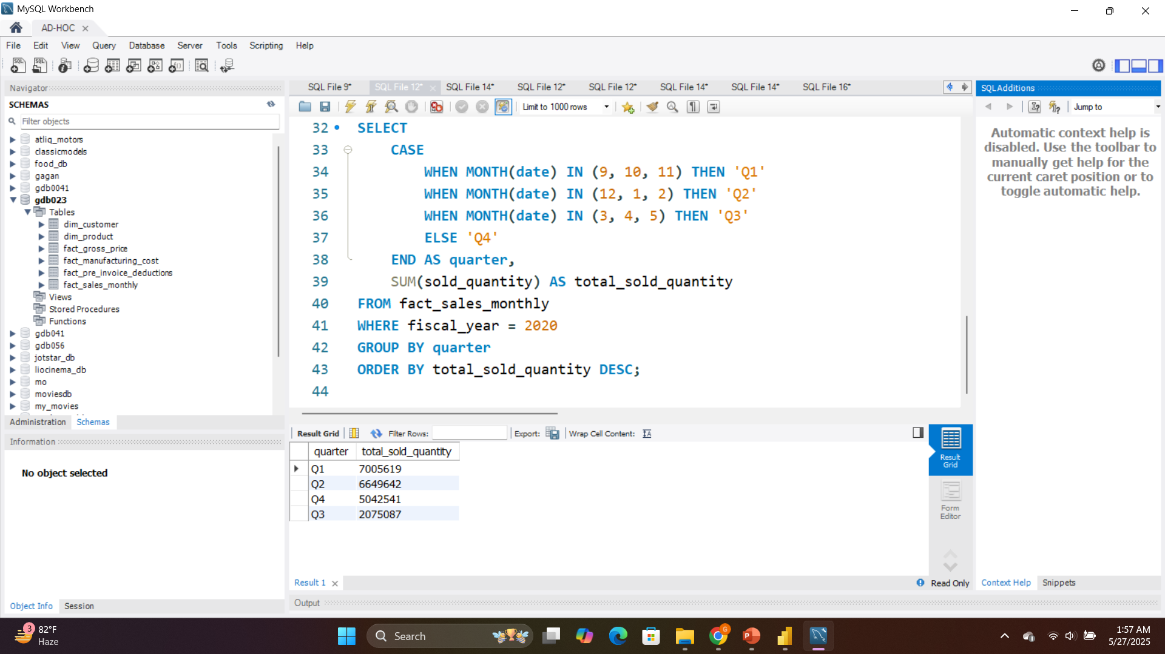
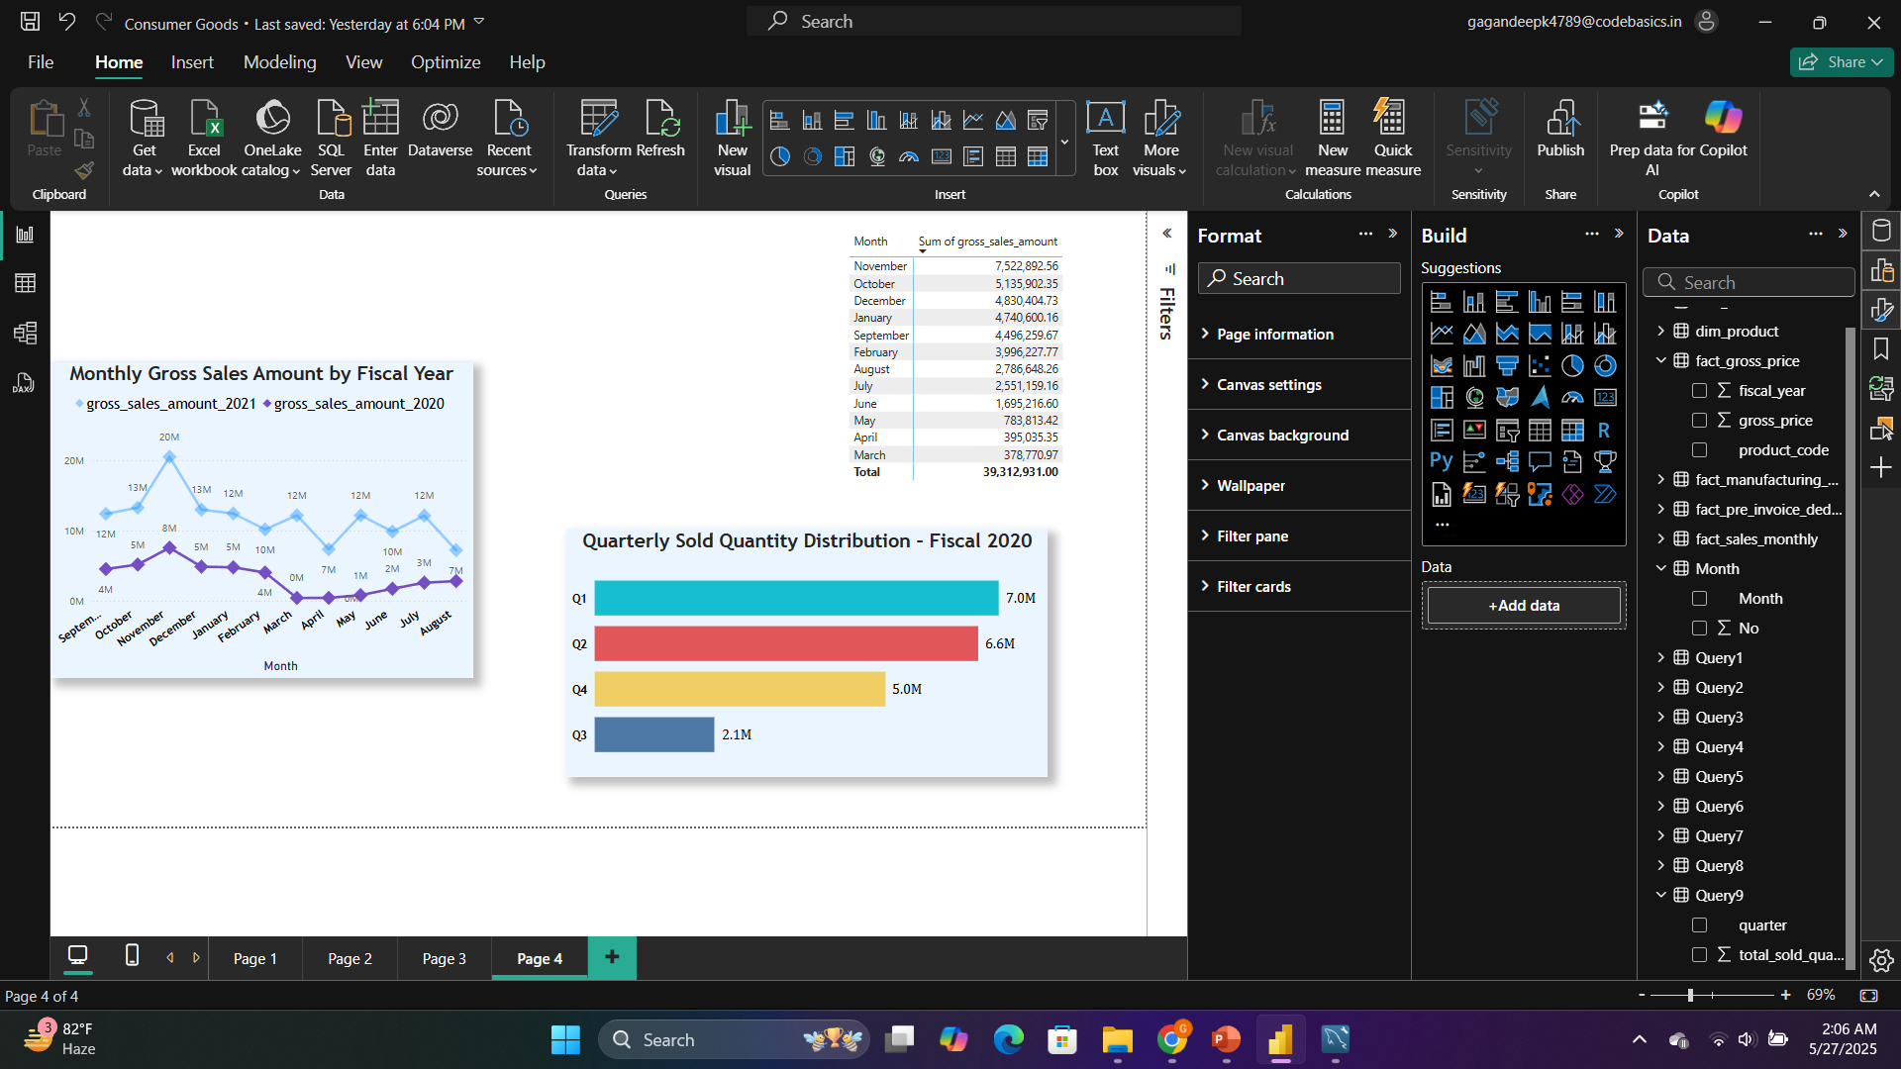
In which quarter of 2020, got the maximum total_sold_quantity? The final output contains these fields Quarter & total_sold_quantity sorted by the total_sold_quantity,

Slide 21
Q3 crashed - Only 2.1M units, way below other quarters
Strong start - Q1 and Q2 were the best performers (7.0M and 6.6M)
Decent recovery - Q4 bounced back to 5.0M units
Front-heavy year - Most sales happened in first half
Bottom line: Started strong, hit a major low in Q3, then partially recovered.

Slide 22
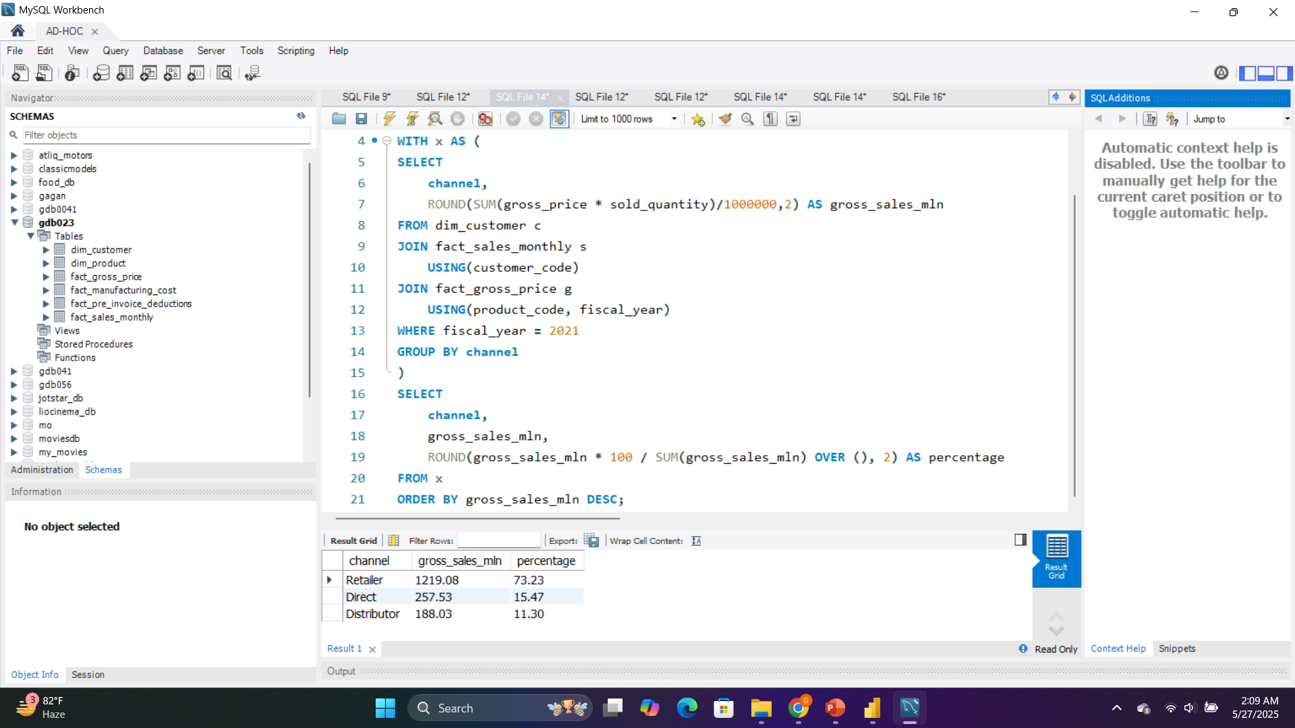
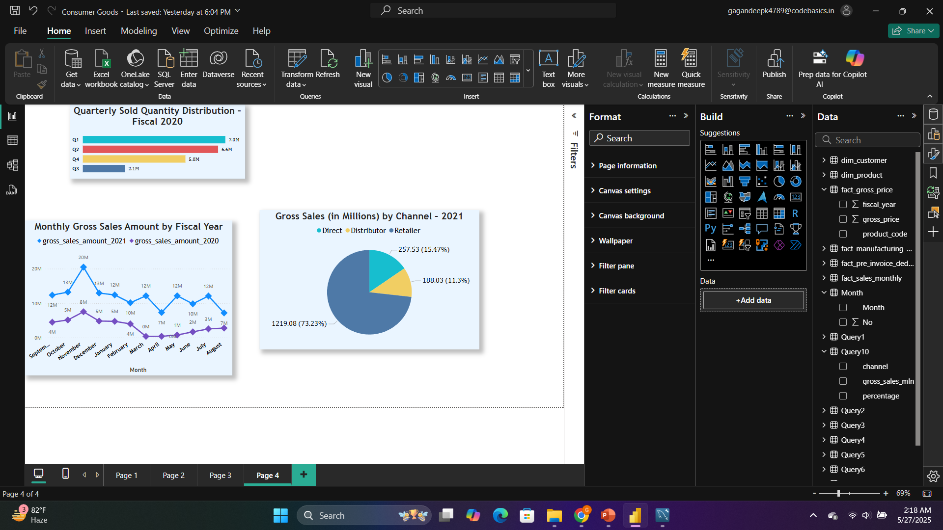
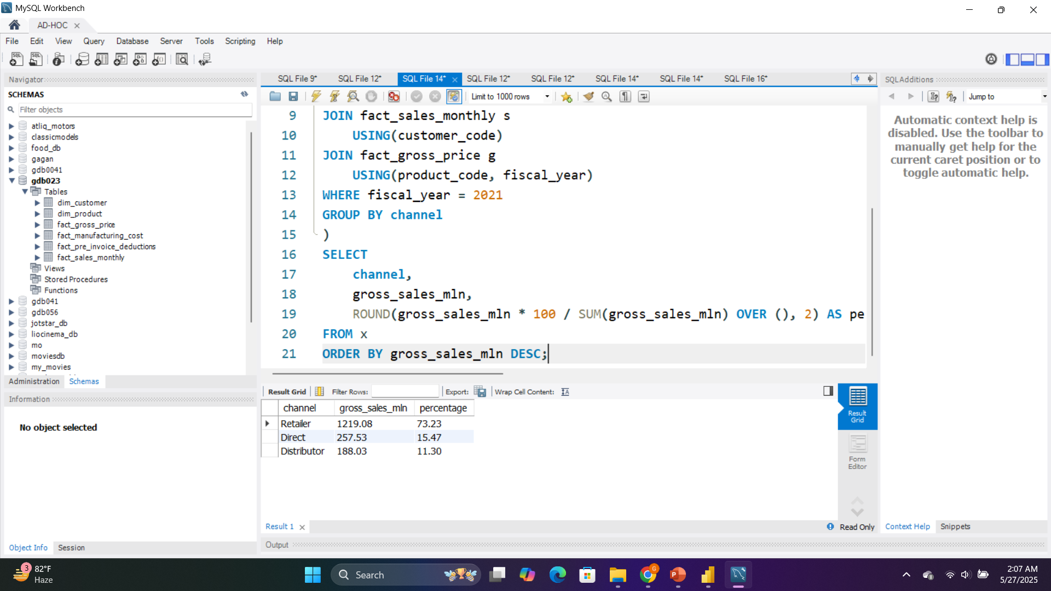
Which channel helped to bring more gross sales in the fiscal year 2021 and the percentage of contribution? The final output contains these fields, channel gross_sales_mln percentage

Slide 23
Retailer dominates - 73% of sales ($1.2B) come through retail partners
Direct sales growing - 15% ($258M) suggests decent direct-to-consumer presence
Distributors smallest - Only 11% ($188M) of total sales
Total revenue: $1.66B
Bottom line: Heavy reliance on retail channel, with direct sales as secondary focus and distributors playing a minor role.

Slide 24
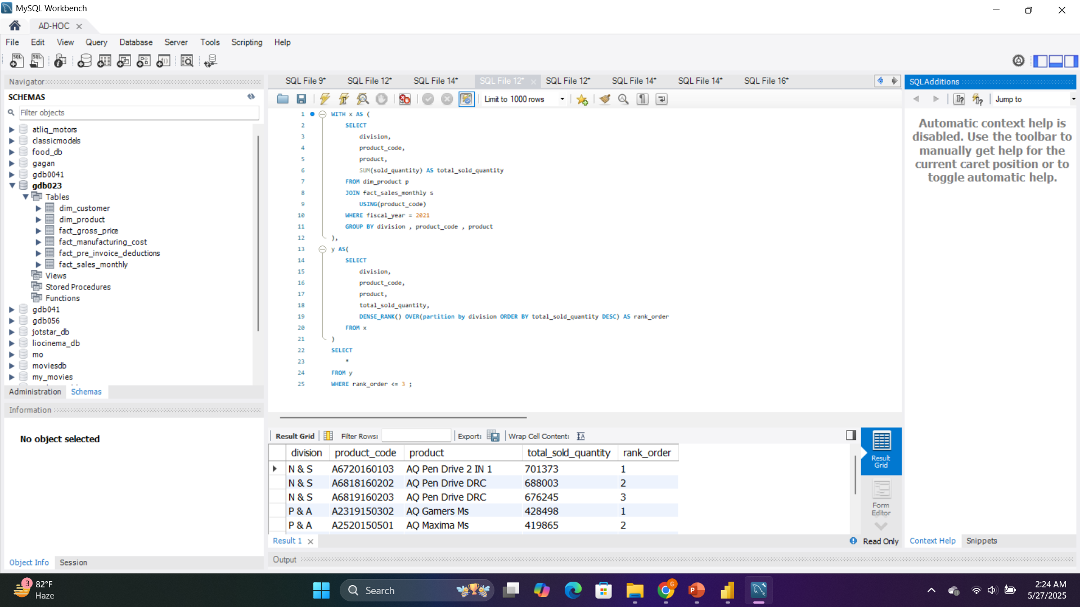
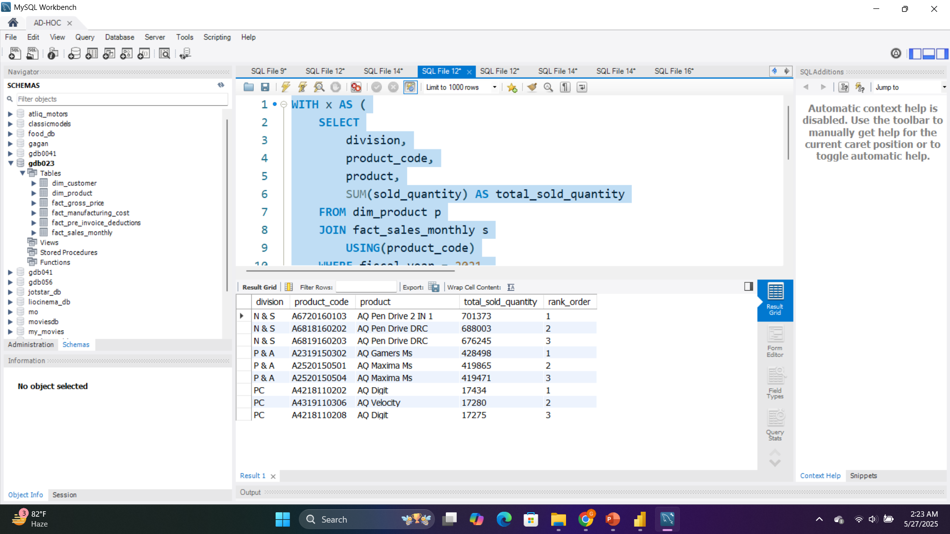
Get the Top 3 products in each division that have a high total_sold_quantity in the fiscal_year 2021? The final output contains these fields, division, product_code, product, total_sold_quantity & rank_order

Slide 25
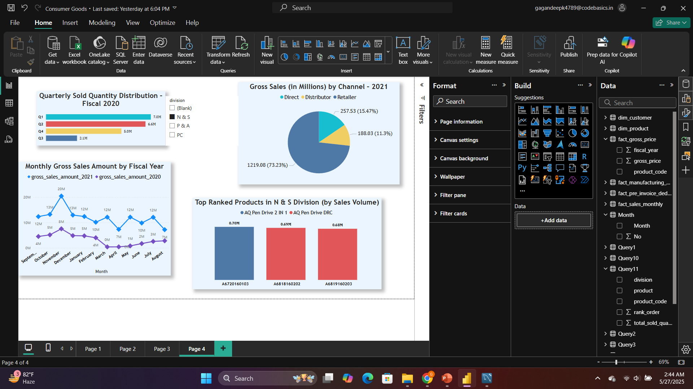
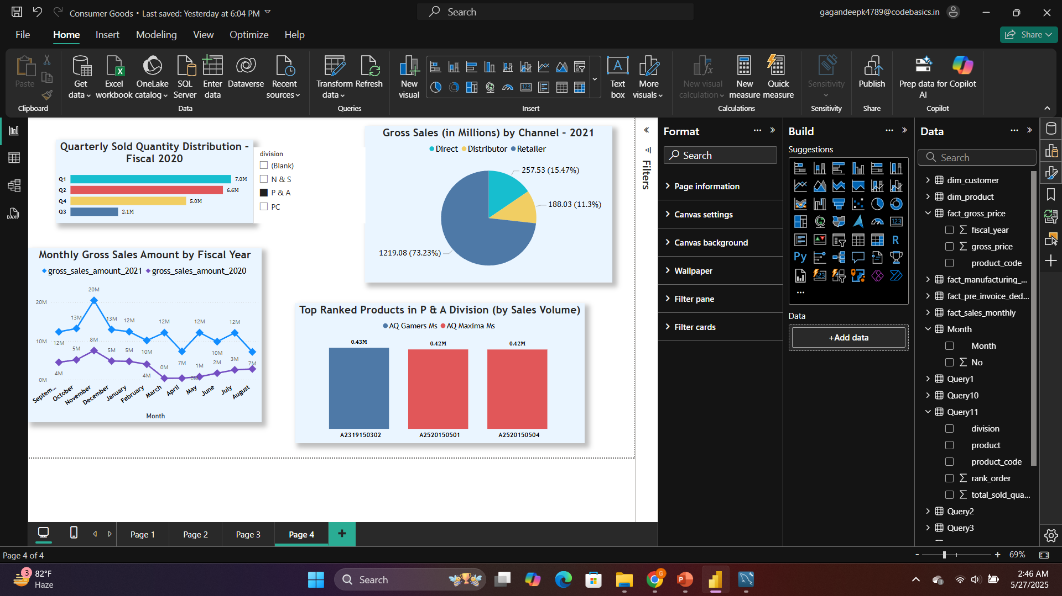
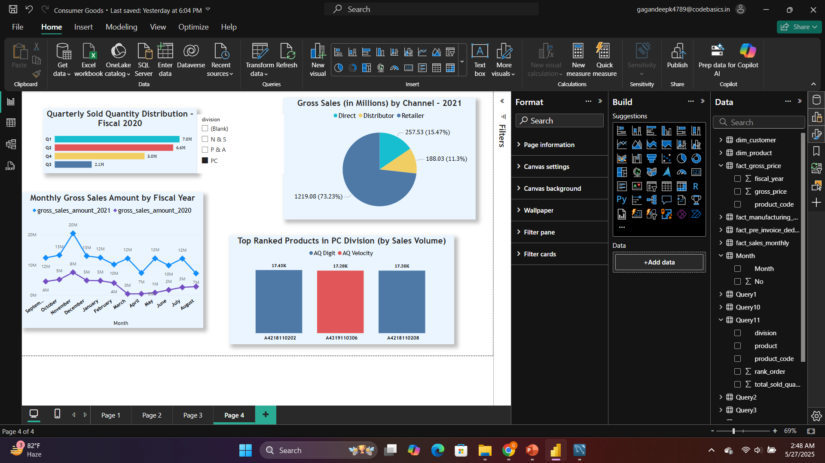

Slide 26
N & S Division dominates - Top 3 products all 600K+ units
P & A strong second - Around 420K units each for top performers
PC Division trails - Only ~17K units for top products
Clear division hierarchy - N & S >> P & A >> PC in sales volume
AQ Pen Drive 2 IN 1 is overall #1 - 701K units across all divisions
Bottom line: Massive performance gap between divisions - N & S sells 40x more than PC division's best products.

Slide 27
